Slide 1
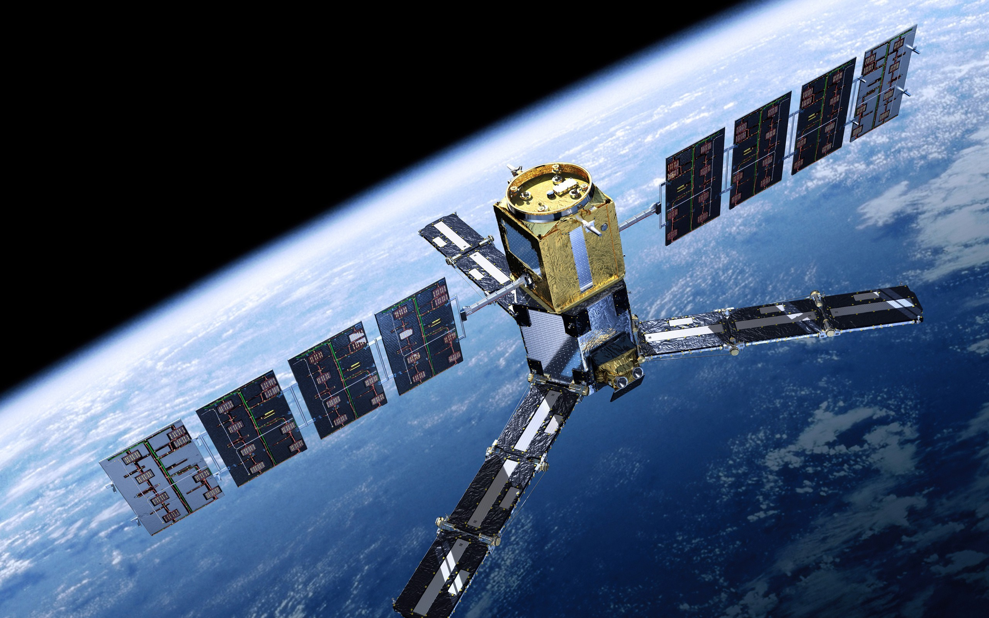
Towards Geospatial Intelligence with AI
Shreya Sharma
Data Science Researcher
NEC Corporation

Slide 2
What is Geospatial Intelligence (GI) ?
Sensing earth from a distance to provide
Earth Observation images
Remote Sensing
Deep Learning
Computer Vision
Learn patterns in data through lots of examples
Making computers see the world as humans
GI

Slide 3


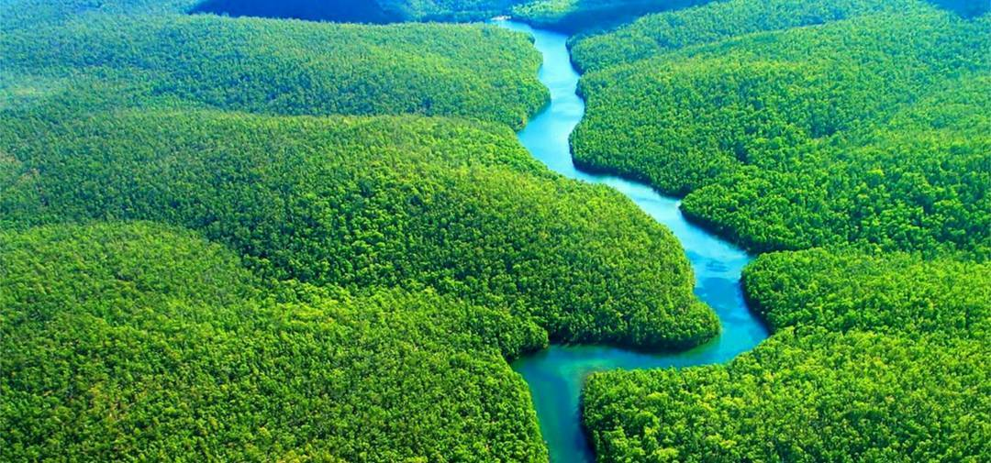
Why Earth Observation (EO) ?
Currently only 25% of the Earth’s surface can be seen by ground sensors
Limits our capability to monitor the entire Earth
Satellite Earth Observation is ‘Eye from the Sky’!

Slide 4
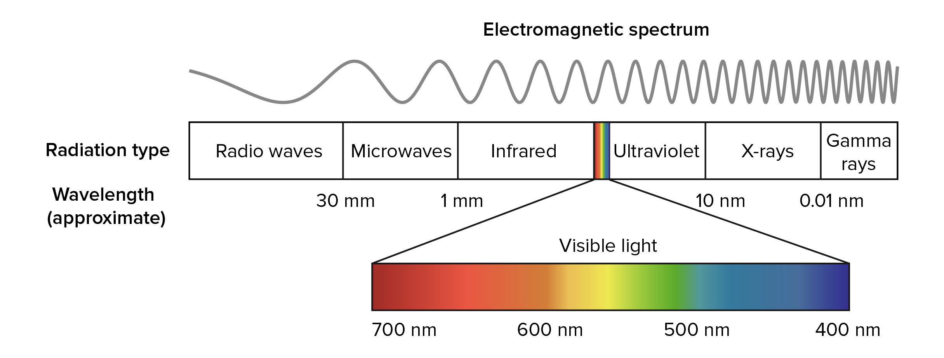



How we see Earth?
Electromagnetic Spectrum

Slide 5
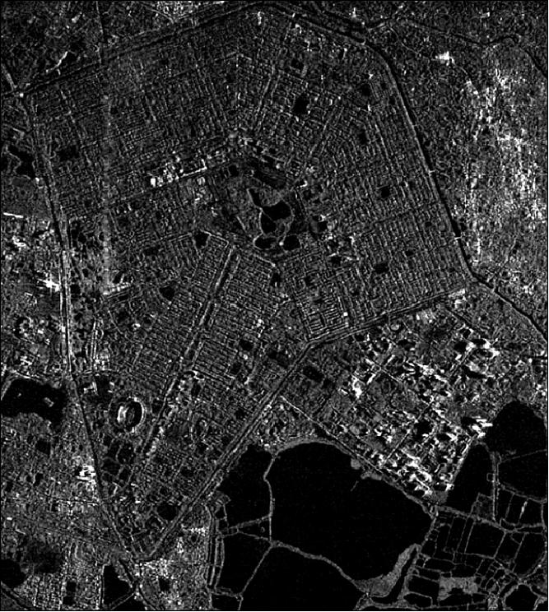
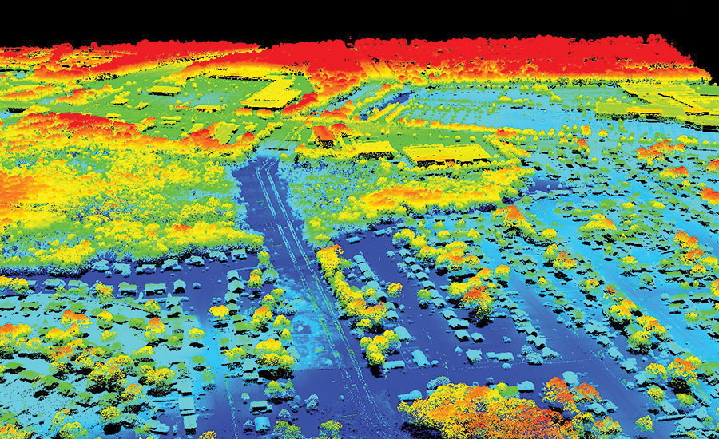
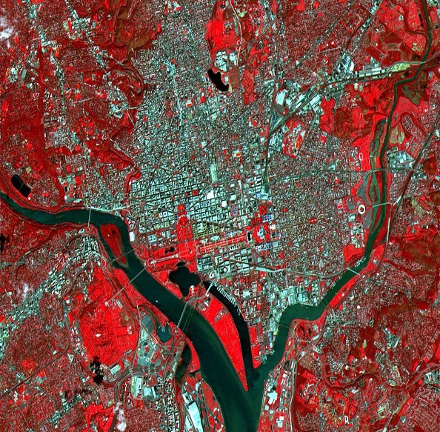
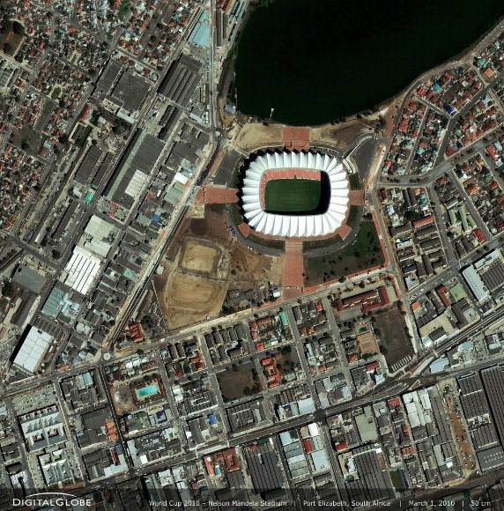
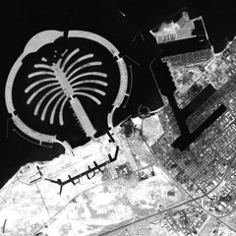
How satellite sees Earth?
Electromagnetic Spectrum
Microwave
LIDAR
Infrared
Visible
Panchromatic
©RISAT
©NASA

Slide 6
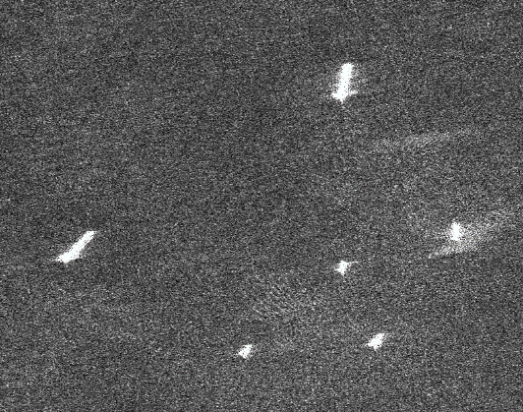
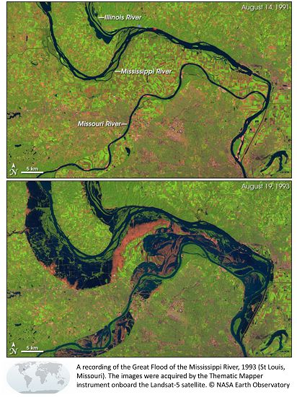
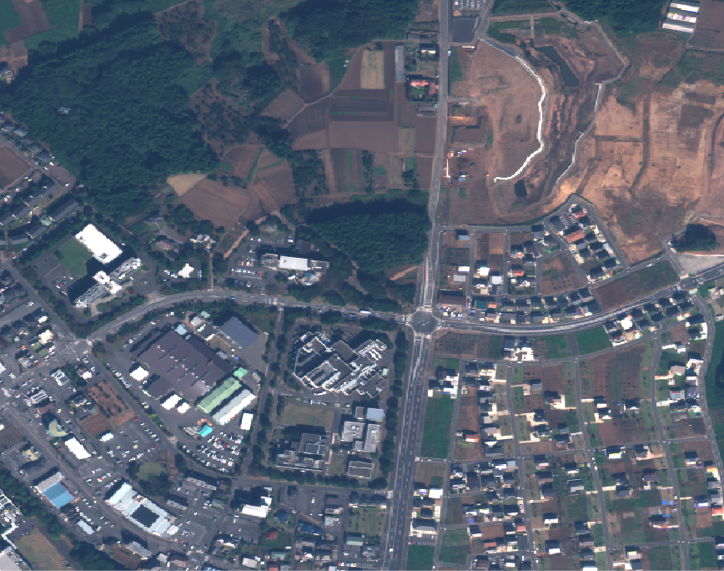
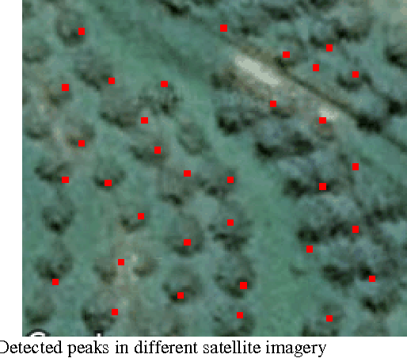
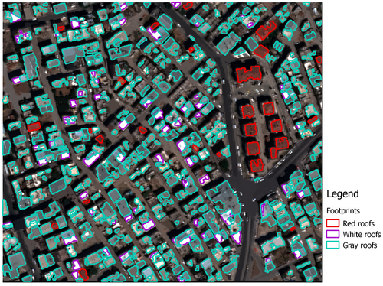
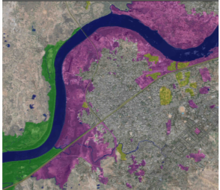
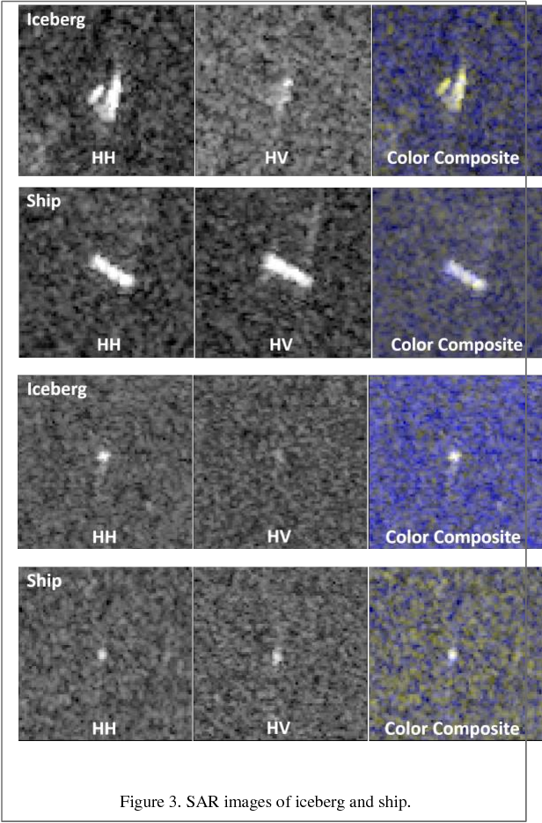
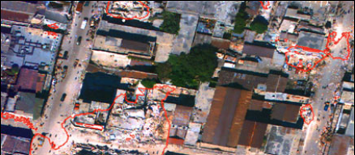
Applications
Recently, so many Earth Observation datasets are coming up
Deep learning is being used to understand the ‘Patterns of our planet’!
Ship Classification
Change Detection
Road Extraction
Tree Counting
Cargo
Before
Tanker
Fishery
Fishery
After
Tug
Cargo
Building Extraction
Land Classification
Iceberg-ship Detection
Disaster Response
Iceberg
Ship
©ENVI
Diverse applications across industries
Notes:
https://arxiv.org/pdf/1805.06561.pdf
https://www.semanticscholar.org/paper/Using-Convolutional-Neural-Networks-to-Count-Palm-Cheang-Cheang/bf75231b5f5345aa0e30e1166552931a04396383

Slide 7
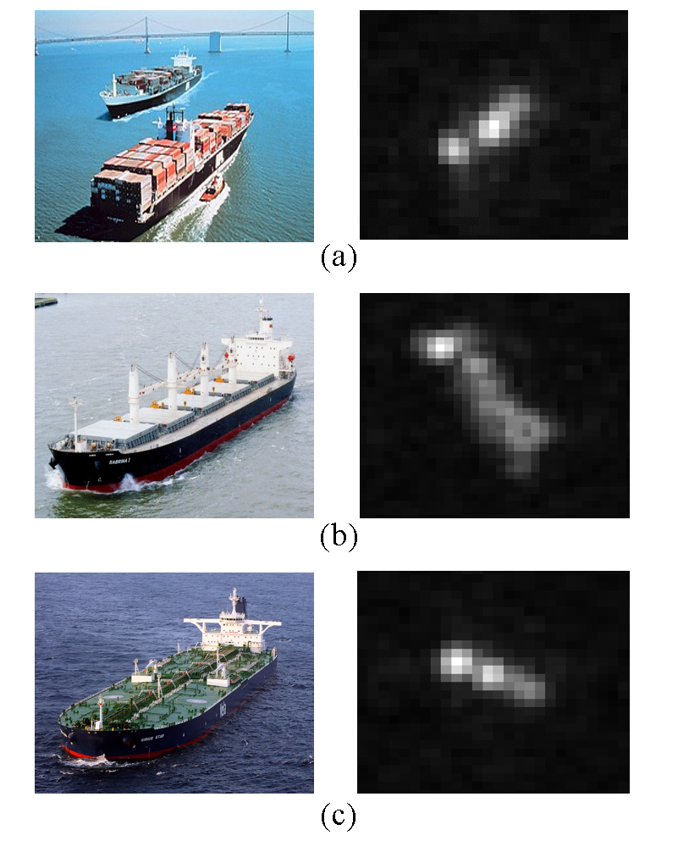
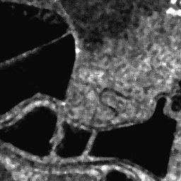
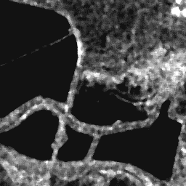
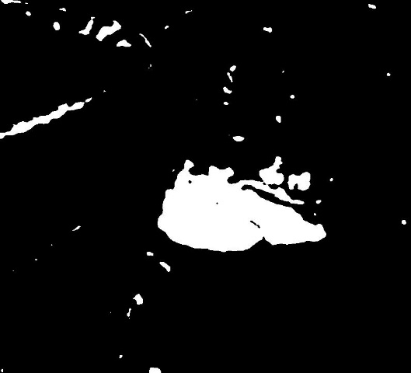
My Research Work : Microwave Images + Deep Learning
Ship Classification
Container
Bulk-carrier
Tanker
© ESA
© ESA
© ESA
Change Detection
Before Image
After Image
Change Map
© ESA
© ESA

Slide 8
My Research Work : Microwave Images + Deep Learning
Ship Classification
Container
Bulk-carrier
Tanker
© ESA
© ESA
© ESA
Change Detection
Before Image
After Image
Change Map
© ESA
© ESA

Slide 9
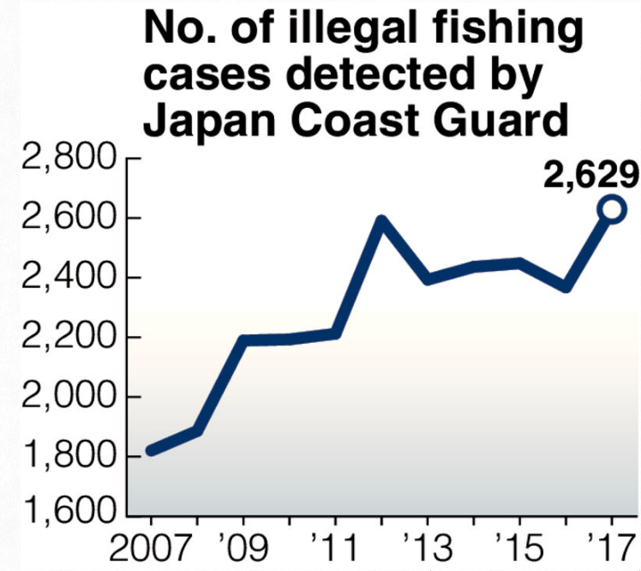
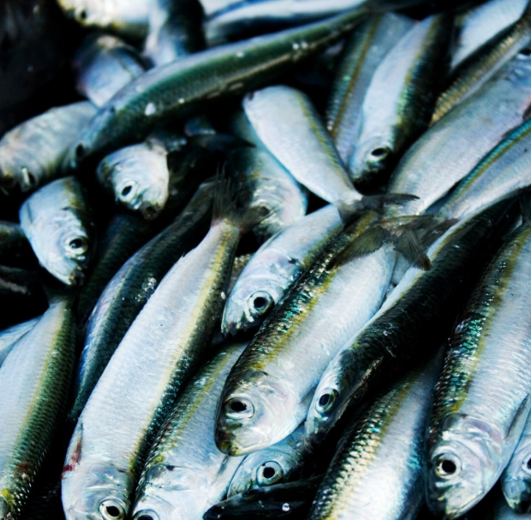
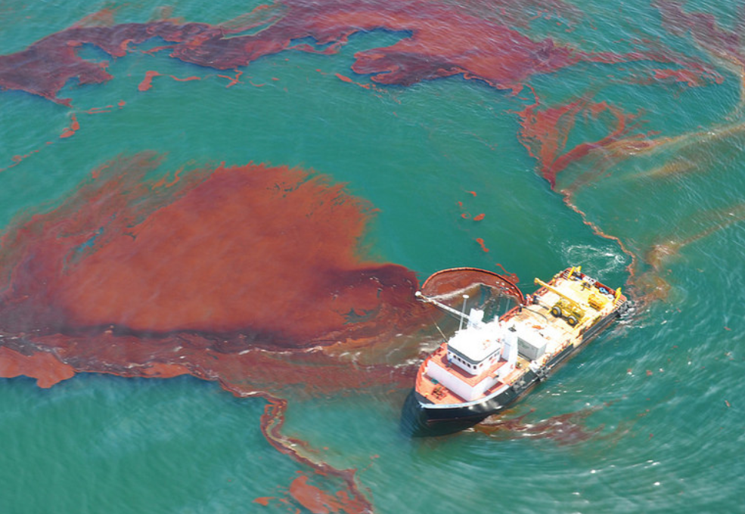
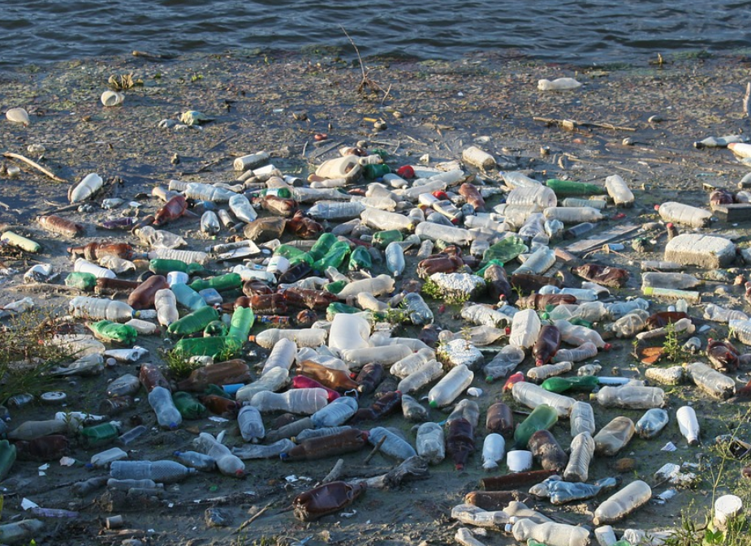
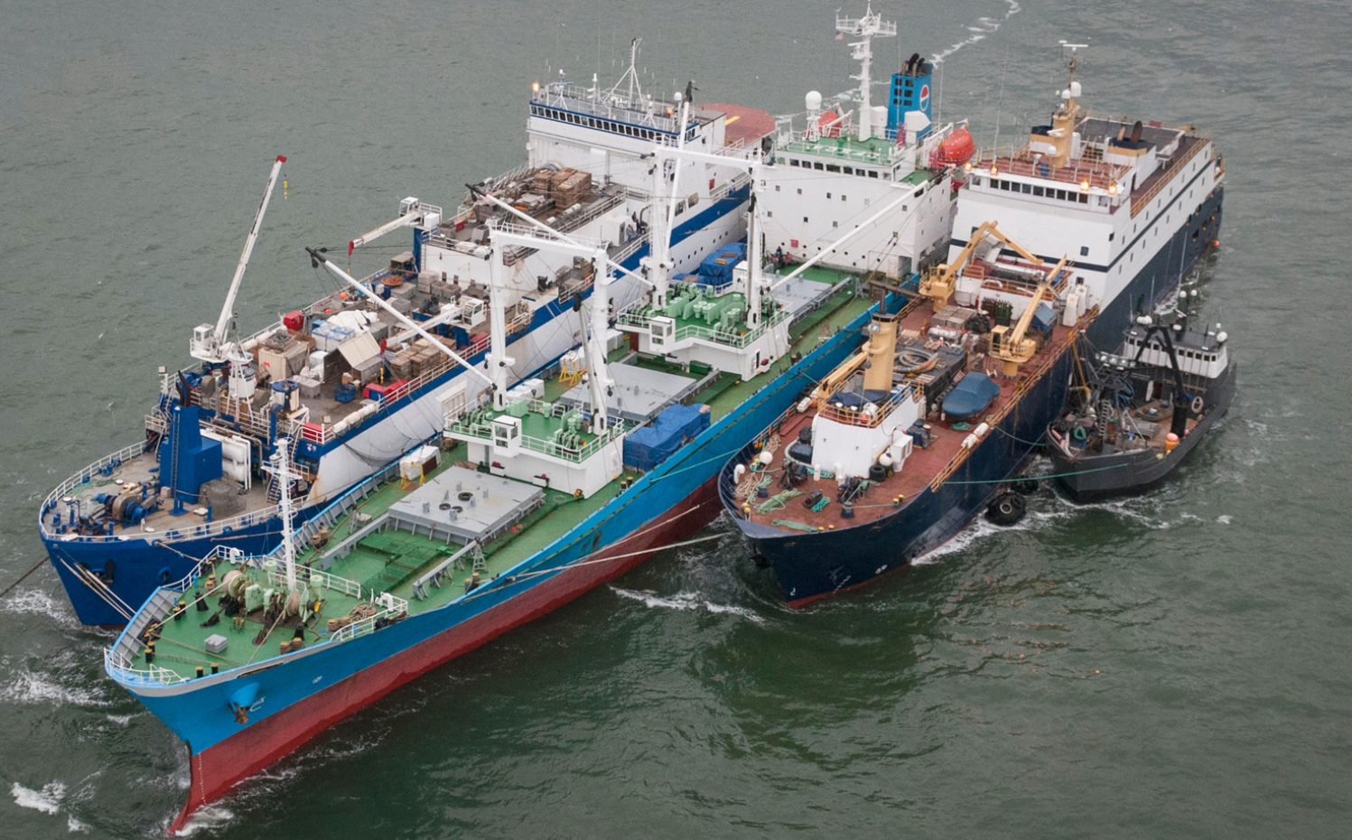
Motivation
Ship Classification is a key application in maritime surveillance
Helps in quick identification of ships involved in illegal activities
Overfishing
Oil-spills
© NOAA/CC BY 2.0
Garbage dump
Smuggling
©Yomiuri Shinbun, 28/02/2018
$US23 billion loss worldwide per year!
© Nature Magazine

Slide 10
Conventional Ship Classification Methods
1. Hand-crafted feature-based
Bounding Box
Feature extractor*
Classifier (SVM)
Class
© JAXA
*Length, Area, Intensity, … etc.
2. Convolutional Neural Network (CNN)-based
CNN
Class
© JAXA
These methods classify a ship based on its appearance in image

Slide 11
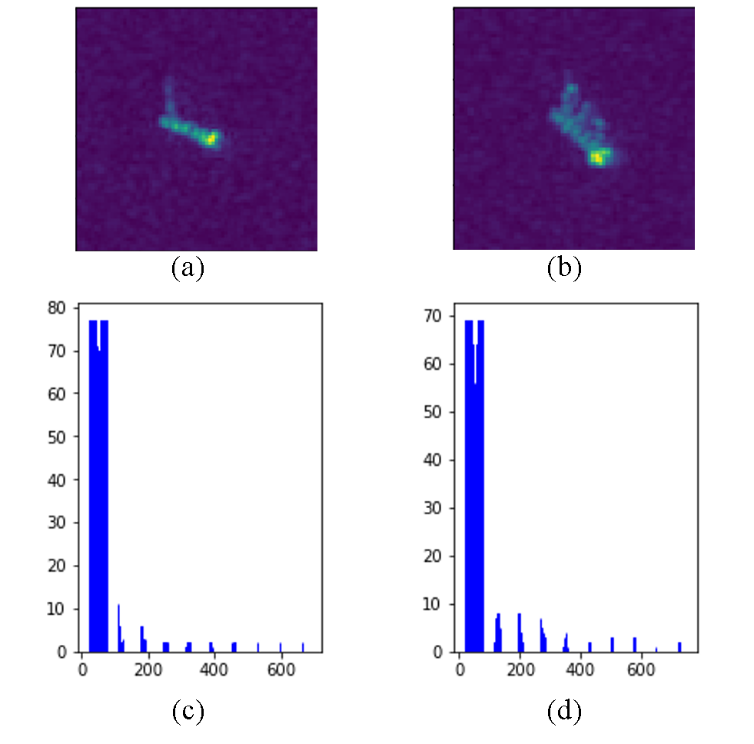
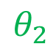

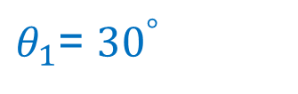
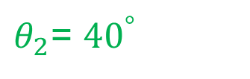
Problem
Appearance of a ship varies with satellite viewing angle
Labelled images are very few to learn all possible variations
Example:
$θ_{1}$= ${30}^{°}$
Satellite
Range
$$θ_{1}$$
$$θ_{2}$$
Same ship viewed under different angles
© JAXA
$θ_{2}$= ${40}^{°}$
Azimuth
© JAXA
Only image information is insufficient for robust classification
Notes:
Explain briefly what is SAR geometry
For cnn to learn all these variations, huge training data is required, but it is not available in SAR.

Slide 12
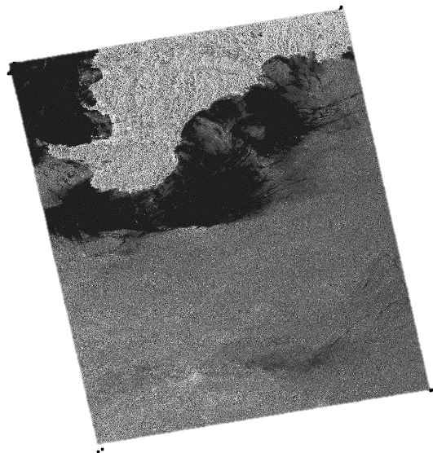



Proposed Method
Use viewing angle as an additional information in a NN
Helps the CNN to follow the appearance changes by learning a relationship
Image
Ship Images
CNN
Ship Class
© JAXA
© JAXA
Viewing angle map
Shows viewing angle at each pixel
Metadata
Extract Viewing Angle Map
$${40}^{°}$$
$${25}^{°}$$
Sharma et al., CNN-based ship classification method incorporating SAR geometry information, SPIE RS 2018.

Slide 13
Experiments
Dataset: OpenSARShip*
Specifications
Satellite | Sentinel-1
Resolution | 20m
Image size | 128 x 128
No. images | 200 per class
Ground truth | AIS + Marine Traffic
Container
© NOAA
© ESA
© ESA
Bulk-carrier
Conventional Methods
© ESA
HCF | 10 Features + SVM
CNN | w/o incident angle
Tanker
Metrics
© ESA
f-measure | Higher is better
#training data | Lower is better
© ESA
*Huang, L et al., "OpenSARShip: A dataset dedicated to Sentinel-1 ship interpretation," IEEE Journal of Sel. Top. in App. Earth Obs. and Rem. Sen. 11(1), 195-208 (2018).

Slide 14
Results
4.2% improvement in
f-measure
25% reduction in
training data requirement
© ESA
Same Acc.
© ESA
© ESA

Slide 15
Demo

Slide 16
My Research Work : Microwave Images + Deep Learning
Ship Classification
Container
Bulk-carrier
Tanker
© ESA
© ESA
© ESA
Change Detection
Before Image
After Image
Change Map
© ESA
© ESA

Slide 17
Motivation
Change detection enables us to understand dynamics of Earth

Slide 18
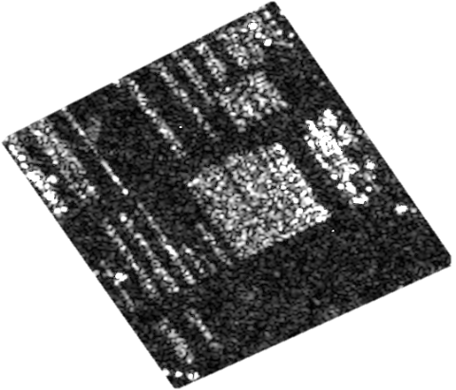
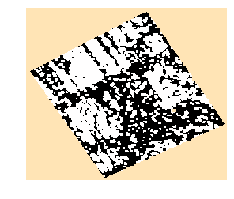
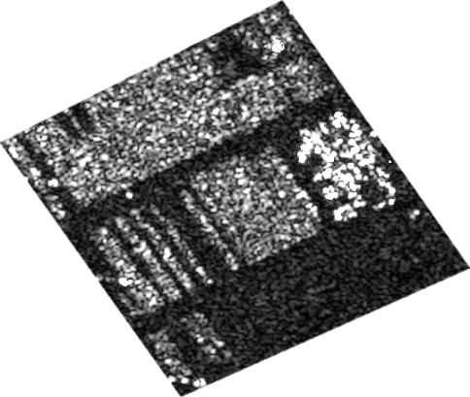
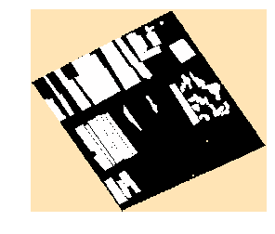
Conventional Method
Based on pixel-to-pixel difference followed by classification
Before Image
Change Map
Pixel-to-pixel difference
Classification
After Image
Ground Truth
Problem:
Many False Alarms!

Slide 19
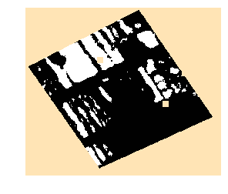
Proposed Method
Transform the images into features and compute difference between features
Before Image
Siamese Network
Change Map
Encoder
Difference
Classification
After Image
Share Weights
Encoder
Sharma et al., Very high resolution SAR change detection with Siamese Networks, The 66th Academic Conference of the Remote Sensing Society of Japan, 2019.

Slide 20
Experiments for Parking Lot Monitoring
…
Specifications
TerraSAR-X satellite
1m resolution
Baselines:
PCA-K [1]
SAE-K [2]
Evaluation Metrics
f-measure
ROC-AUC
[1] T. Celik: Unsupervised change detection in satellite images using principal component analysis and k-means clustering, IEEE Geoscience and Remote Sensing Letters, vol. 6, no. 4, pp. 772-776, 2009.
[2] M. Gong., H. Yang, and P. Zhang: Feature learning and change feature classification based on deep learning for ternary change detection in SAR images, ISPRS Journal of Photogr. and Remote Sensing, no.129, pp.212-225, 2017.
Dataset
t1
t2
t3
t9
t10
…
Site 1
…
Site 2
…
…
Site 3
Site 4
…
All images are copyrighted to DLR
…
Test
Site 5
Pair 1
Pair 2
Pair 9

Slide 21
Result [1/2] : f-measure
Proposed methods improves f-measure by xx% over baselines
+0.4
+0.25

Slide 22
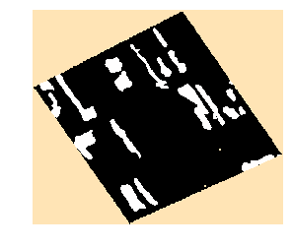
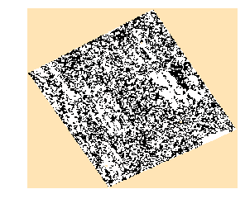
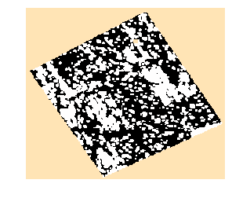
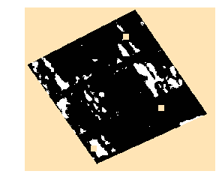
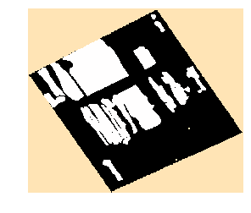
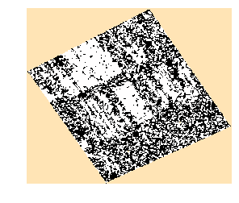
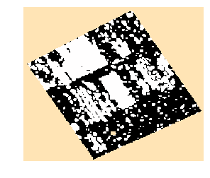
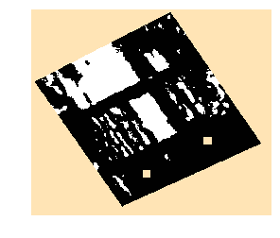
Result [2/2] : Change Maps
Proposed method produces visually better change maps
Ground Truth
PCA-K
SAE-K
Proposed
Pair 1
Pair 2

Slide 23
Conclusion

